Slide 1
Stable Diffusion Architecture

Slide 2
Stable Diffusion is an advanced model architecture for text-to-image conversion, featuring a robust set of components.
The main components of Stable Diffusion are: - Variational Autoencoder (VAE) - CLIP Encoder - U-Net Architecture - Latent Diffusion Models - Text-to-Image Prompts

Slide 3
Variational AutoEncoder
Variational Autoencoder (VAE)
Purpose: VAEs are designed for dimensionality reduction and generative modeling.
Functionality: A VAE compresses data into a latent space (dimensionality reduction) and can also generate new data by sampling from this latent space (generative modeling).
Application: Often used in image generation, data compression, anomaly detection, and more.
Unique Aspects: VAEs use a stochastic approach to encode data into a probabilistic latent space, allowing for both inference and sampling.

Slide 4
CLIP
Purpose: The CLIP Encoder is part of the CLIP model, which connects images and text.
Functionality: It encodes textual descriptions and images into a common latent space, allowing the model to understand both modalities in a unified way.
Application: Useful for multimodal tasks like text-to-image matching, image retrieval, and zero-shot classification.
Unique Aspects: The CLIP model was trained on a large dataset of image-caption pairs, enabling it to generalize well to various tasks without specific retraining.

Slide 5
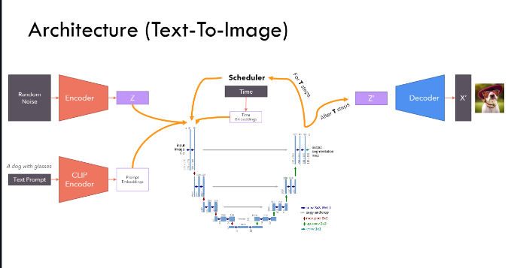
Stable Diffusion has broad applications in graphic design, digital art, and content creation. It powers advanced AI-based text-to-image systems.

Slide 6
Stable Diffusion is a powerful architecture for converting text to image. It encompasses several key components and has various applications.

